Slide 1

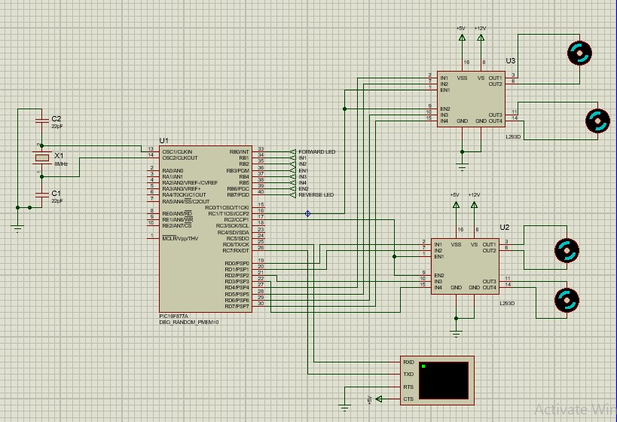
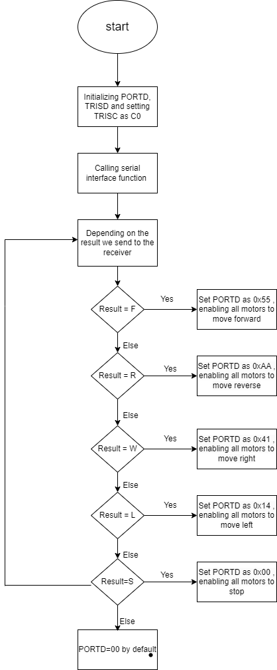
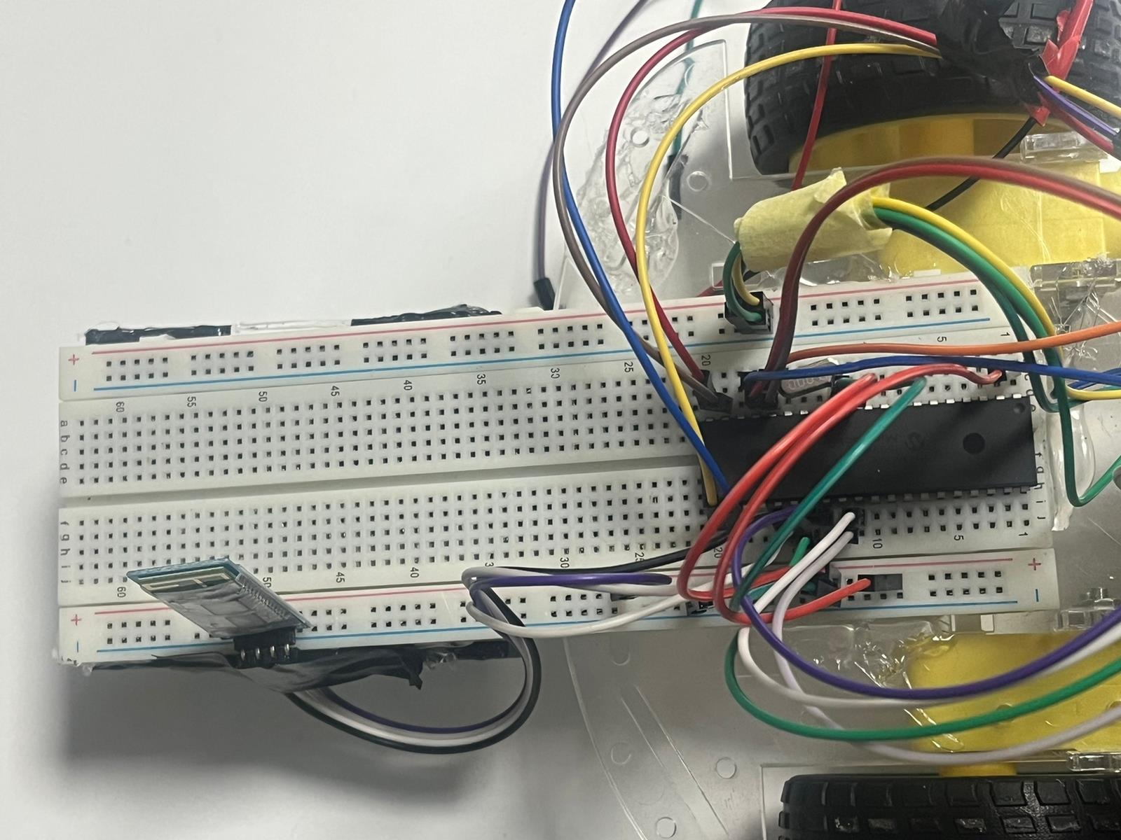
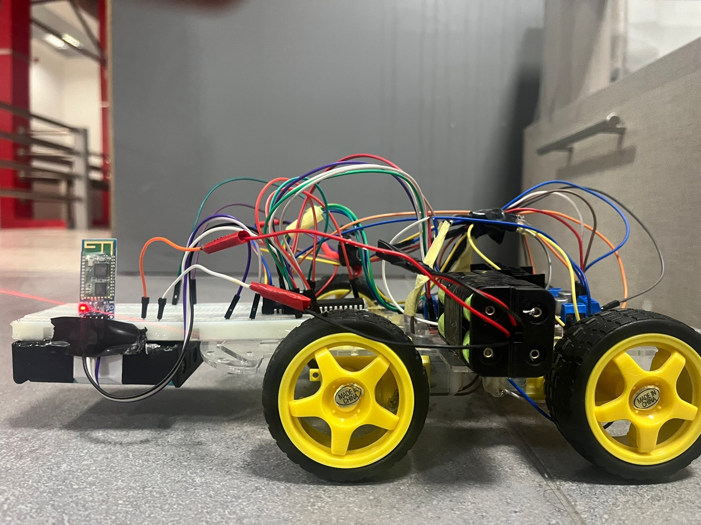
Robo Car
L. Abdeen, F. Al-Khatib and R.Yacoub
Supervisor: Dr. Belal Sababha
Embedded Systems Final Design Project, Fall 2022
King Abdullah II School of Engineering
Princess Sumaya University for Technology
Design
Our project was designed by PIC16F877A that control a car which consist of hc-06 Bluetooth module , h,bridge , DC motors.
Figure 1: Electrical Circuit Diagram
Introduction
This introduction describes a project that utilizes the PIC16F877A microcontroller to implement a Bluetooth-enabled car control system. The system allows for remote control of the car's movement and other functions through a smartphone or other Bluetooth-enabled device. The PIC16F877A microcontroller is responsible for receiving and interpreting commands from the Bluetooth device and controlling the car's movements from their motors. The system also includes various sensors and actuators to provide feedback on the car's status and respond to commands. This project demonstrates the versatility and capabilities of the PIC16F877A microcontroller in controlling and communicating with various devices and systems.
Results
The implementation of a Bluetooth car using the PIC16F877A microcontroller was successful. The car was able to move forward, backward, left, and right using commands sent via Bluetooth from a smartphone. The car was also able to stop and change speed based on the commands received.
Figure 3: Breadboard connections.
Figure 4: Final prototype.
Figure 2 : Flow Chart Diagram.
Conclusion
In conclusion, the use of the PIC16F877A microcontroller in a Bluetooth car system can provide a reliable and efficient way to control and communicate with the car. The microcontroller's powerful processing capabilities and built-in communication protocols make it an ideal choice for this application. Additionally, the use of Bluetooth technology allows for easy and seamless connectivity between the car and other devices, such as smartphones and tablets. Overall, the combination of the PIC16F877A microcontroller and Bluetooth technology can greatly enhance the functionality and convenience of a car system.

